Slide 1
Wind as a Resource

Slide 2
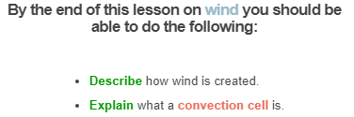
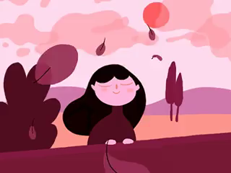

Slide 3
Chances are that you are quite familiar with the wind. But do you know why wind actually happens?
Wind is the movement of air from one point to another. The speed of the wind depends on how fast the air is moving.
It can even move fast enough to knock over trees and break buildings!
So how does the air get enough energy to go that fast?

Slide 4
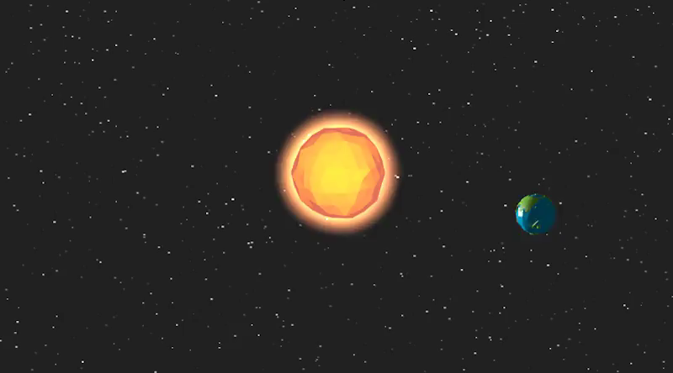
Wind is generated because of air temperature.
The Sun heats the Earth and the air around it. The Earth reflects heat and this is absorbed by the air, heating it more.

Slide 5

When air is heated it rises - you can see this when you boil water. The steam rises to the top of the room.
This happens with air heated by the sun too, so you get hot air rising. As the air rises it cools down, and eventually falls back down to the ground.

Slide 6
This means that air moves in circles. It travels along the ground, up into the air, and then back down to the ground again.
This is called a convection cell.
Horizontal air flow is called wind.
Vertical air flows are called thermals.

Slide 7
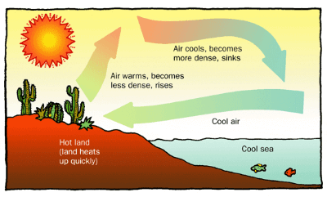

Slide 8
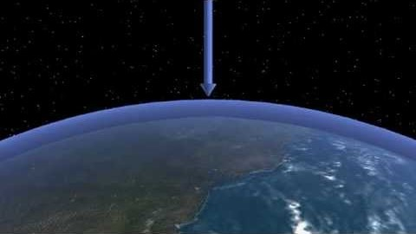

Slide 9
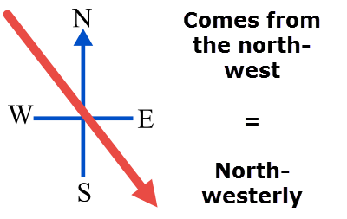
We name the winds by the direction the winds come from.
This means that wind coming from the east and going to the west would be called an easterly wind.
For example:

Slide 10
Convection cells happen naturally along coastlines.
During the day the ground heats up faster than the water, and therefore the air over the land is warmer than the air over the sea.
This creates an onshore wind - the wind blows from the sea to the land.

Slide 11
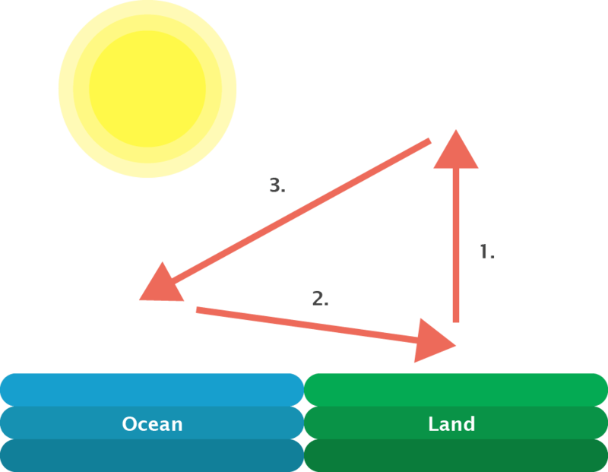
There are three steps in the formation of onshore wind:
First, as air over the land is heated it rises.
This causes cooler air from the sea to blow in.
Then, the hot air cools and falls down to the ocean.

Slide 12
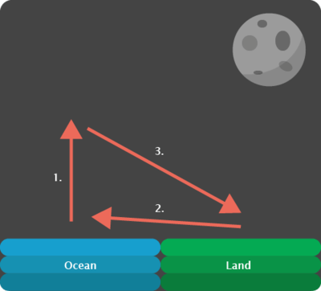
Air over the land also cools quicker than the ocean, so at night the ocean air becomes warmer.
This creates an offshore wind - the wind blows from the land to the sea.

Slide 13
There are three steps in the formation of offshore winds:
The warmer air over the sea rises.
Cooler air from the land blows out to sea.
The hot air cools and falls down to the land.

